Slide 1


MODULE 3 :
INTRODUCTION TO GITHUB
PREPARED BY:
Dr. Nurulaqilla Khamis
Center for Artificial Intelligence and Robotics
Universiti Teknologi Malaysia

Slide 2
MODULE OUTLINE
01
03
Overview of GitHub Features & Benefits
Creating GitHub Account
02
04
What is Repository?
Creating New Repository GitHub

Slide 3

01
OVERVIEW OF GITHUB FEATURES & BENEFITS

Slide 4


GITHUB FEATURES & BENEFITS
Online Hosting Platform for Git Repository
Developers to Collaborate on Project
Track Changes to Code
Individual Developers & Small Team

Slide 5
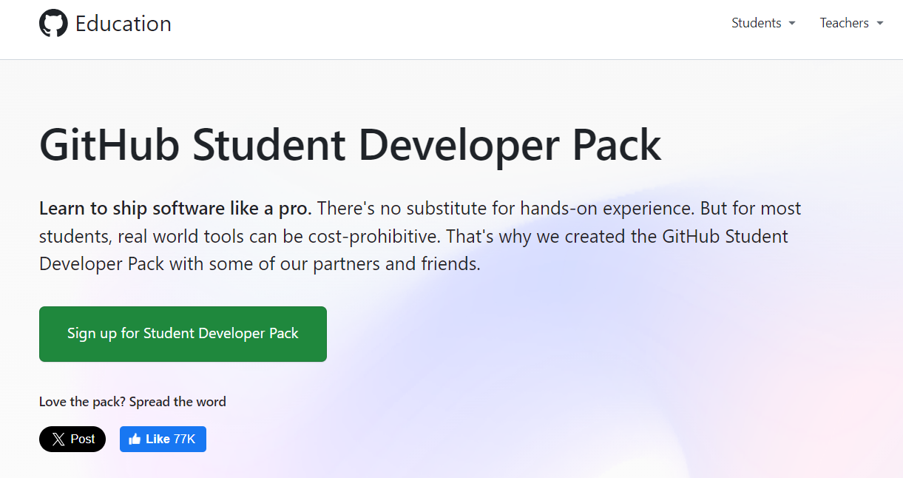
GITHUB FEATURES & BENEFITS
https://education.github.com/pack#offers

Slide 6
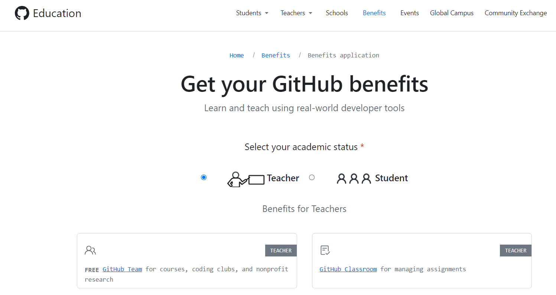
GITHUB FEATURES & BENEFITS
https://education.github.com/discount_requests/application
Autograding Assignment

Slide 7
02
WHAT IS REPOSITORY?

Slide 8
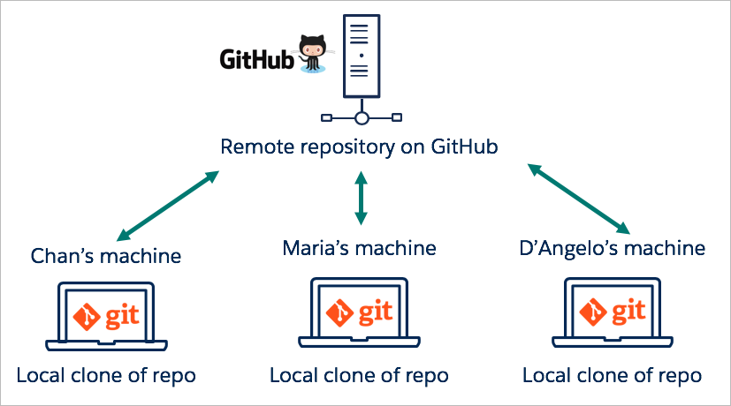
WHAT IS REPOSITORY?
Repository : is a storage space to accommodate the projects
The location can be local to a folder on user computer or it can be a storage space on GitHub
2. Create Project Repositories
at Central Repo (GitHub)
Initialize Repositories (Locally)
from Local Machine

Slide 9
03
CREATING GITHUB ACCOUNT

Slide 10
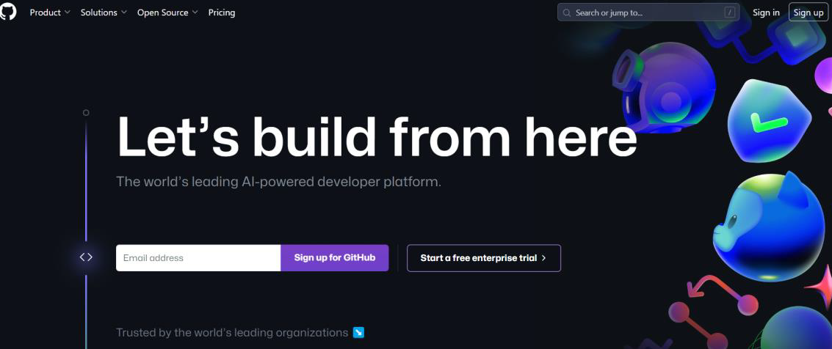
Go to this website www.github.com and sign up for new user
Please use your personal email account (ensure that similar email use for git configuration)

Slide 11
04
CREATING NEW REPOSITORY GITHUB

Slide 12
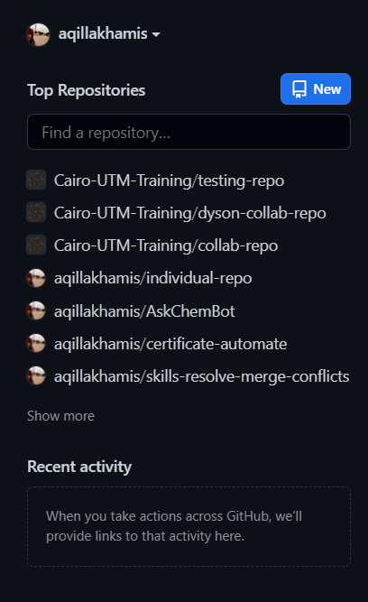
click “New” for new repository

Slide 13
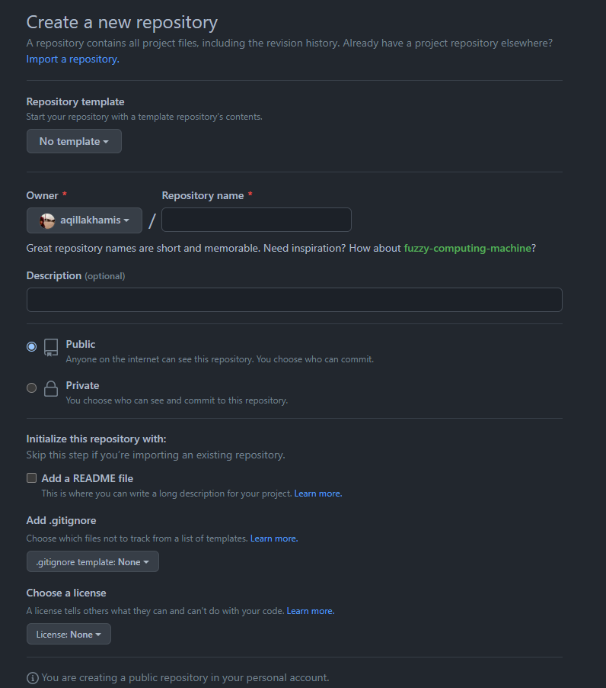

Repository name: Create similar project name from your local machine repo - “GitHubProject”
Description – Optional
Public @ Private Repo? (Your Choice)
Click “Create repository”

Slide 14
cairo@utm.my / trainer’s email

